Slide 1
Decomposition

Slide 2
A functional decomposition is the process of breaking down the functions of an organization into progressively greater (finer and finer) levels of detail.
Decomposition helps in eliminating some of the problems of bad design such as redundancy, inconsistencies and anomalies.
When a relation in the relational model is not appropriate normal form then the decomposition of a relation is required. In a database, breaking down the table into multiple tables termed as decomposition.

Slide 3
Undesirable Properties of Bad Design
Redundancy, resulting in waste of space and complicated updates (inconsistencies.)
Inability to represent certain information – ex Null values.
Loss of information.

Slide 4
How to avoid ?
Properties of information repetition and null values suggest -- Decomposition of relation schema.
Properties of information loss -- Non-lossy-join decomposition.

Slide 5
Properties of a relational decomposition
Attribute Preservation.
Dependency preservation.
Non Additive Join Property:
Minimal redundancy or No redundancy
Lossless Join:

Slide 6
Attribute Preservation

Slide 7
1. Lossless Join Decomposition
One of the properties of bad design suggests to decompose a relation into smaller relations.
Must achieve lossless-join decomposition.

Slide 8
1. Lossless Join Decomposition
Definition:
Let { R1, R2 } be a decomposition of R (R1 U R2 = R); the decomposition is lossless if for every legal instance r of R:
r = ΠR1(r) |X| ΠR2(r)

Slide 9
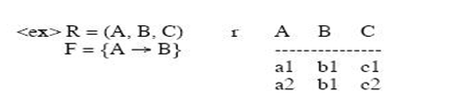
1. Lossless Join Decomposition
R1= A , B R2=A ,C
R1 R2= A
R1-R2= B

Slide 10
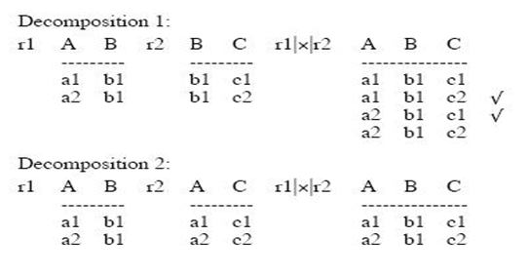
1. Lossless Join Decomposition

Slide 11
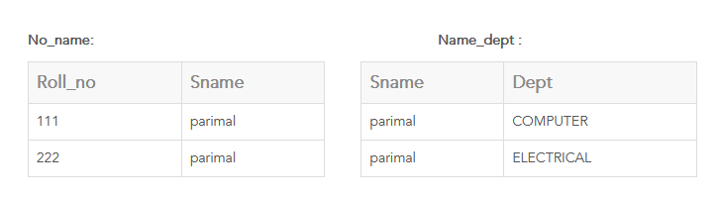

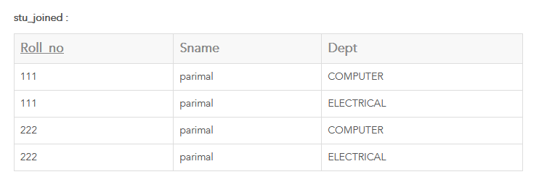

Slide 12
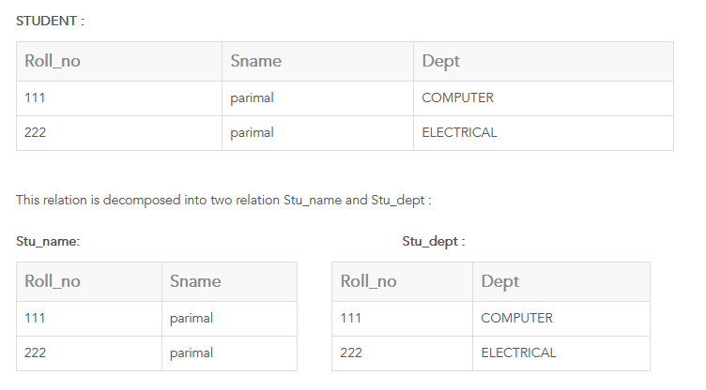


Slide 13
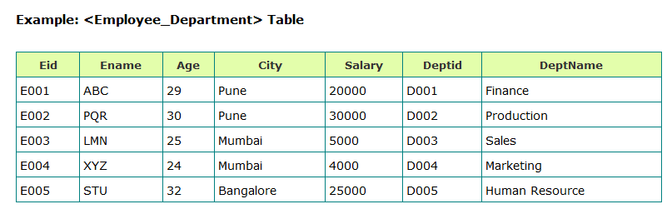
1. Lossless Join Decomposition

Slide 14
Testing Lossless Join
Lossless join property is necessary if the decomposed relation is to be recovered from its decomposition.
Let R be a schema and F be a set of FD’s on R, and α = (R1, R2) be a decomposition of R. Then α has a lossless join with respect to F iff
R1 ∩ R2 -> ( R1 - R2 ) or
R2 ∩ R1 -> ( R2 - R1 )
where such FD exist in Closure of F
This is a sufficient condition, but not a necessary
condition.

Slide 15
Example of L-J Decomposition
From the previous example : R = (ABC) F = {A -> B}
R1 = (AB), R2 = (AC)
R1∩ R2 = A, R1- R2 = B
check A -> B in F ? Yes. Therefore lossless
R1 = (AB), R2 = (BC)
R1∩ R2 = B, R1 - R2 = A , R2 - R1= C
check B -> A in F ? NO
check B -> C in F ? NO
So, this is lossy join.

Slide 16
Another example
R = (City, Street, Zip) F = {CS -> Z, Z -> C}
R1 = (CZ) R2 = (SZ)
R1 ∩ R2 = Z , R1 – R2 = (C)
check Z -> C in F ? Yes
Therefore, the decomposition to be (CZ) (SZ) is
lossless join decomposition.

Slide 17
2. Dependency preservation.
Why do we preserve the dependency?
We would like to check easily that updates to the database do not result in illegal relations being created.
It would be nice if our design allowed us to check updates without having to compute natural joins.

Slide 18
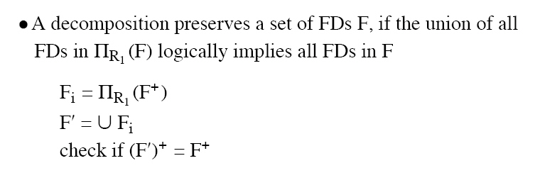
Dependency Preservation Decomposition
Definition: Each FD specified in F either appears directly in one of the relations in the decomposition, or be inferred from FDs that appear in some relation.

Slide 19
Test of Dependency Preservation
If a decomposition is not dependency-preserving, some dependency is lost in the decomposition.
One way to verify that a dependency is not lost is to take joins of two or more relations in the decomposition to get a relation that contains all of the attributes in the dependency under consideration and then check that the dependency holds on the result of the joins.

Slide 20
Test of Dependency Preservation II
Find F - F', the functional dependencies not checkable in one relation.
See whether this set is obtainable from F' by using Armstrong's Axioms.
This should take a great deal less work, as we have (usually) just a few functional dependencies to work on.

Slide 21
Dependency Preserving Example
Consider relation ABCD, with FD’s :
A ->B, B ->C, C ->D

Slide 22
Dependency Preserving Example
Consider relation ABCD, with FD’s :
A ->B, B ->C, C ->D
Decompose into two relations: ABC and CD.

Slide 23
Dependency Preserving Example
Consider relation ABCD, with FD’s :
A ->B, B ->C, C ->D
Decompose into two relations: ABC and CD.
ABC supports the FD’s A->B, B->C.
CD supports the FD C->D.
All the original dependencies are preserved.

Slide 24
Non-Dependency Preserving Example
Consider relation ABCD, with FD’s:
A ->B, B ->C, C->D
Decompose into two relations: ACD and BC.
ACD supports the FD B ->C and implied FD A ->C.
BC supports the FD B->C.
However, no relation supports A ->B.
So the dependency is not preserved.

Slide 25
Minimal Redundancy
In order to achieve the lack of redundancy, we do some decomposition which is represented by several normal forms.

Slide 26
Normal Form Decompositions Comparison
3NF Decomposition:
lossless.
Dependency preserving.
BCNF Decomposition:
Lossless.
Not necessarily dependency-preserving.
Component relations are all BCNF, and thus 3NF.
4NF Decomposition:
Lossless.
Not necessarily are all 4NF, and thus BCNF and 3NF.
No decomposition is guaranteed to preserve all multi-value dependencies.

Slide 27
Lossless Check Example
Consider five attributes: ABCDE
Three relations: ABC, AD, BDE
FD’s: A ->BD, B ->E
 | A | B | C | D | E
ABC | a1 | a2 | a3 | b14 | b15
AD | a1 | b22 | b23 | a4 | b25
BDE | b21 | a2 | b33 | a4 | a5

Slide 28
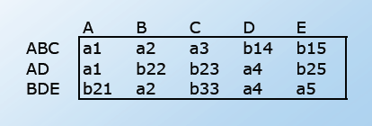
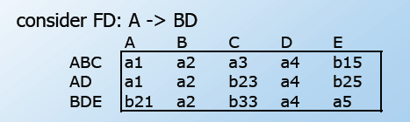
Lossless Check Example

Slide 29
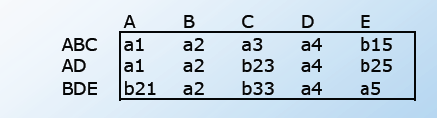
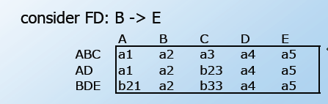
Lossless Check Example

Slide 30
Conclusion
Decompositions should always be lossless.
Decompositions should be dependency preserving whenever possible.
We have to perform the normal decomposition to make sure we get rid of the minimal redundant information.

Slide 31
Reference
http://www.cs.hmc.edu/courses/2004/spring/cs133/decomp.6.pdf
http://www.cs.sfu.ca/CC/354/zaiane/material/notes/Chapter7/node8.html
http://clem.mscd.edu/~tuckerp/CSI3310/C15.1.html
http://wwwis.win.tue.nl/~aaerts/2M400/pdf/ColNotes7.pdf

